Slide 1
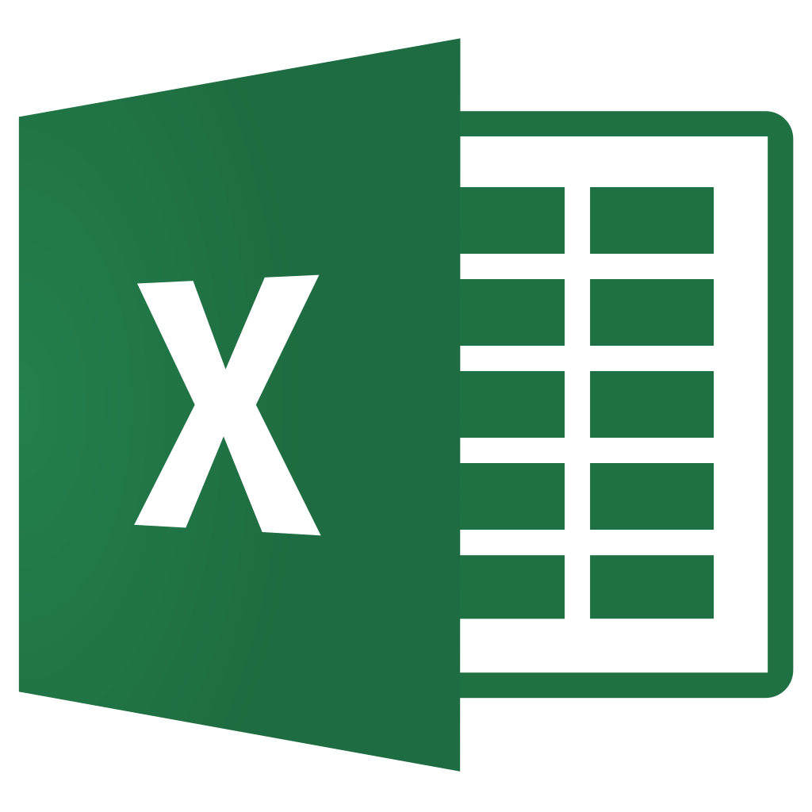

What You'll Learn

Slide 2
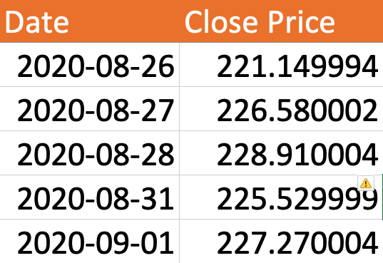
1. Pull Historical Stock Data
2. Predict Stocks with Moving Average
3. Visualize Accuracy

Slide 3
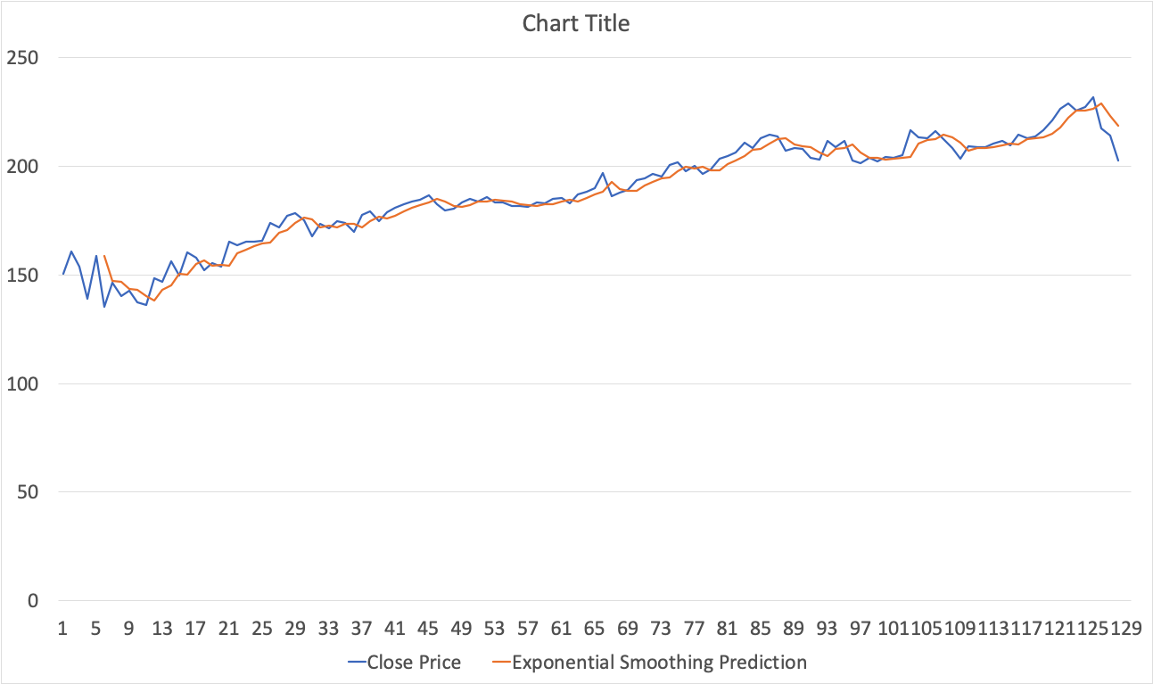
4. What is Exponential Smoothing?
5. Predict Stocks with Exponential Smoothing

Slide 4
What You'll Learn ✓
Let’s begin...

